Slide 1

Quality of Life Plan
Seeking Citizen Input and Visions for Our Future
Monday, April 22, 2024

Slide 2


Duncan Heart & soul Updates
What do YOU love about Duncan?
“We believe the strength of every community lies in the hands and hearts of the people who live there.”
- Duncan Heart and Soul

Slide 3
Duncan High School S.T.E.M. Classes
106 Surveys Completed – freshman and sophomores completed the S.W.O.T. and “Big Ticket” Survey
The students were energized during the discussion and wanted to share their thoughts on making Duncan a better community.
Students want:
Variety of restaurants and shopping experiences
Entertainment opportunities
More festivals and events
Cleaner, greener community
Improved infrastructure
Safer neighborhoods
Employment opportunities
“The foundation of every state is the education of its youth.”
- Diogenes

Slide 4
AARP Age-Friendly Community
According to the U.S. Census Bureau, by 2034 the nation will have more people age 65 or older than under 18. By 2060, nearly 1 in 4 people in the United States will be at lest 65 years old.
AARP Network of Age-Friendly States and Communities supports the work of local, regional, and state governments as they prepare for the nation’s changing demographics.
The “network” is comprised of communities that have made a commitment to being more livable for people of all ages, and especially older adults.
Oklahoma currently has one community in the “network” – Guthrie, OK
Should Duncan, OK become the second community in the “network?”
“The longer I live, the more beautiful life becomes.”
- Frank Lloyd Wright

Slide 5
Recap March 26, 2024
Categories Discussed
Housing
Neighborhood: Engagement & Opportunity
Transportation
Infrastructure
General Information Provided
Some categories will need to be expanded into new categories
Several items were discussed that will need additional research by staff
General information that will be used to establish future goals and objectives
Key players were shared that should be involved with the future planning process
“Data are just summaries of thousands of stories – tell a few of those stories to help make the date meaningful.”
- Dan Heath

Slide 6
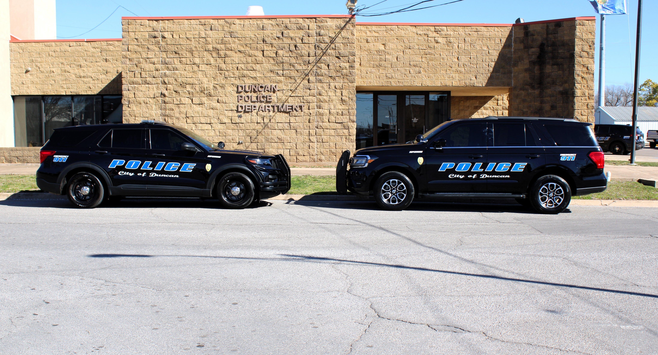
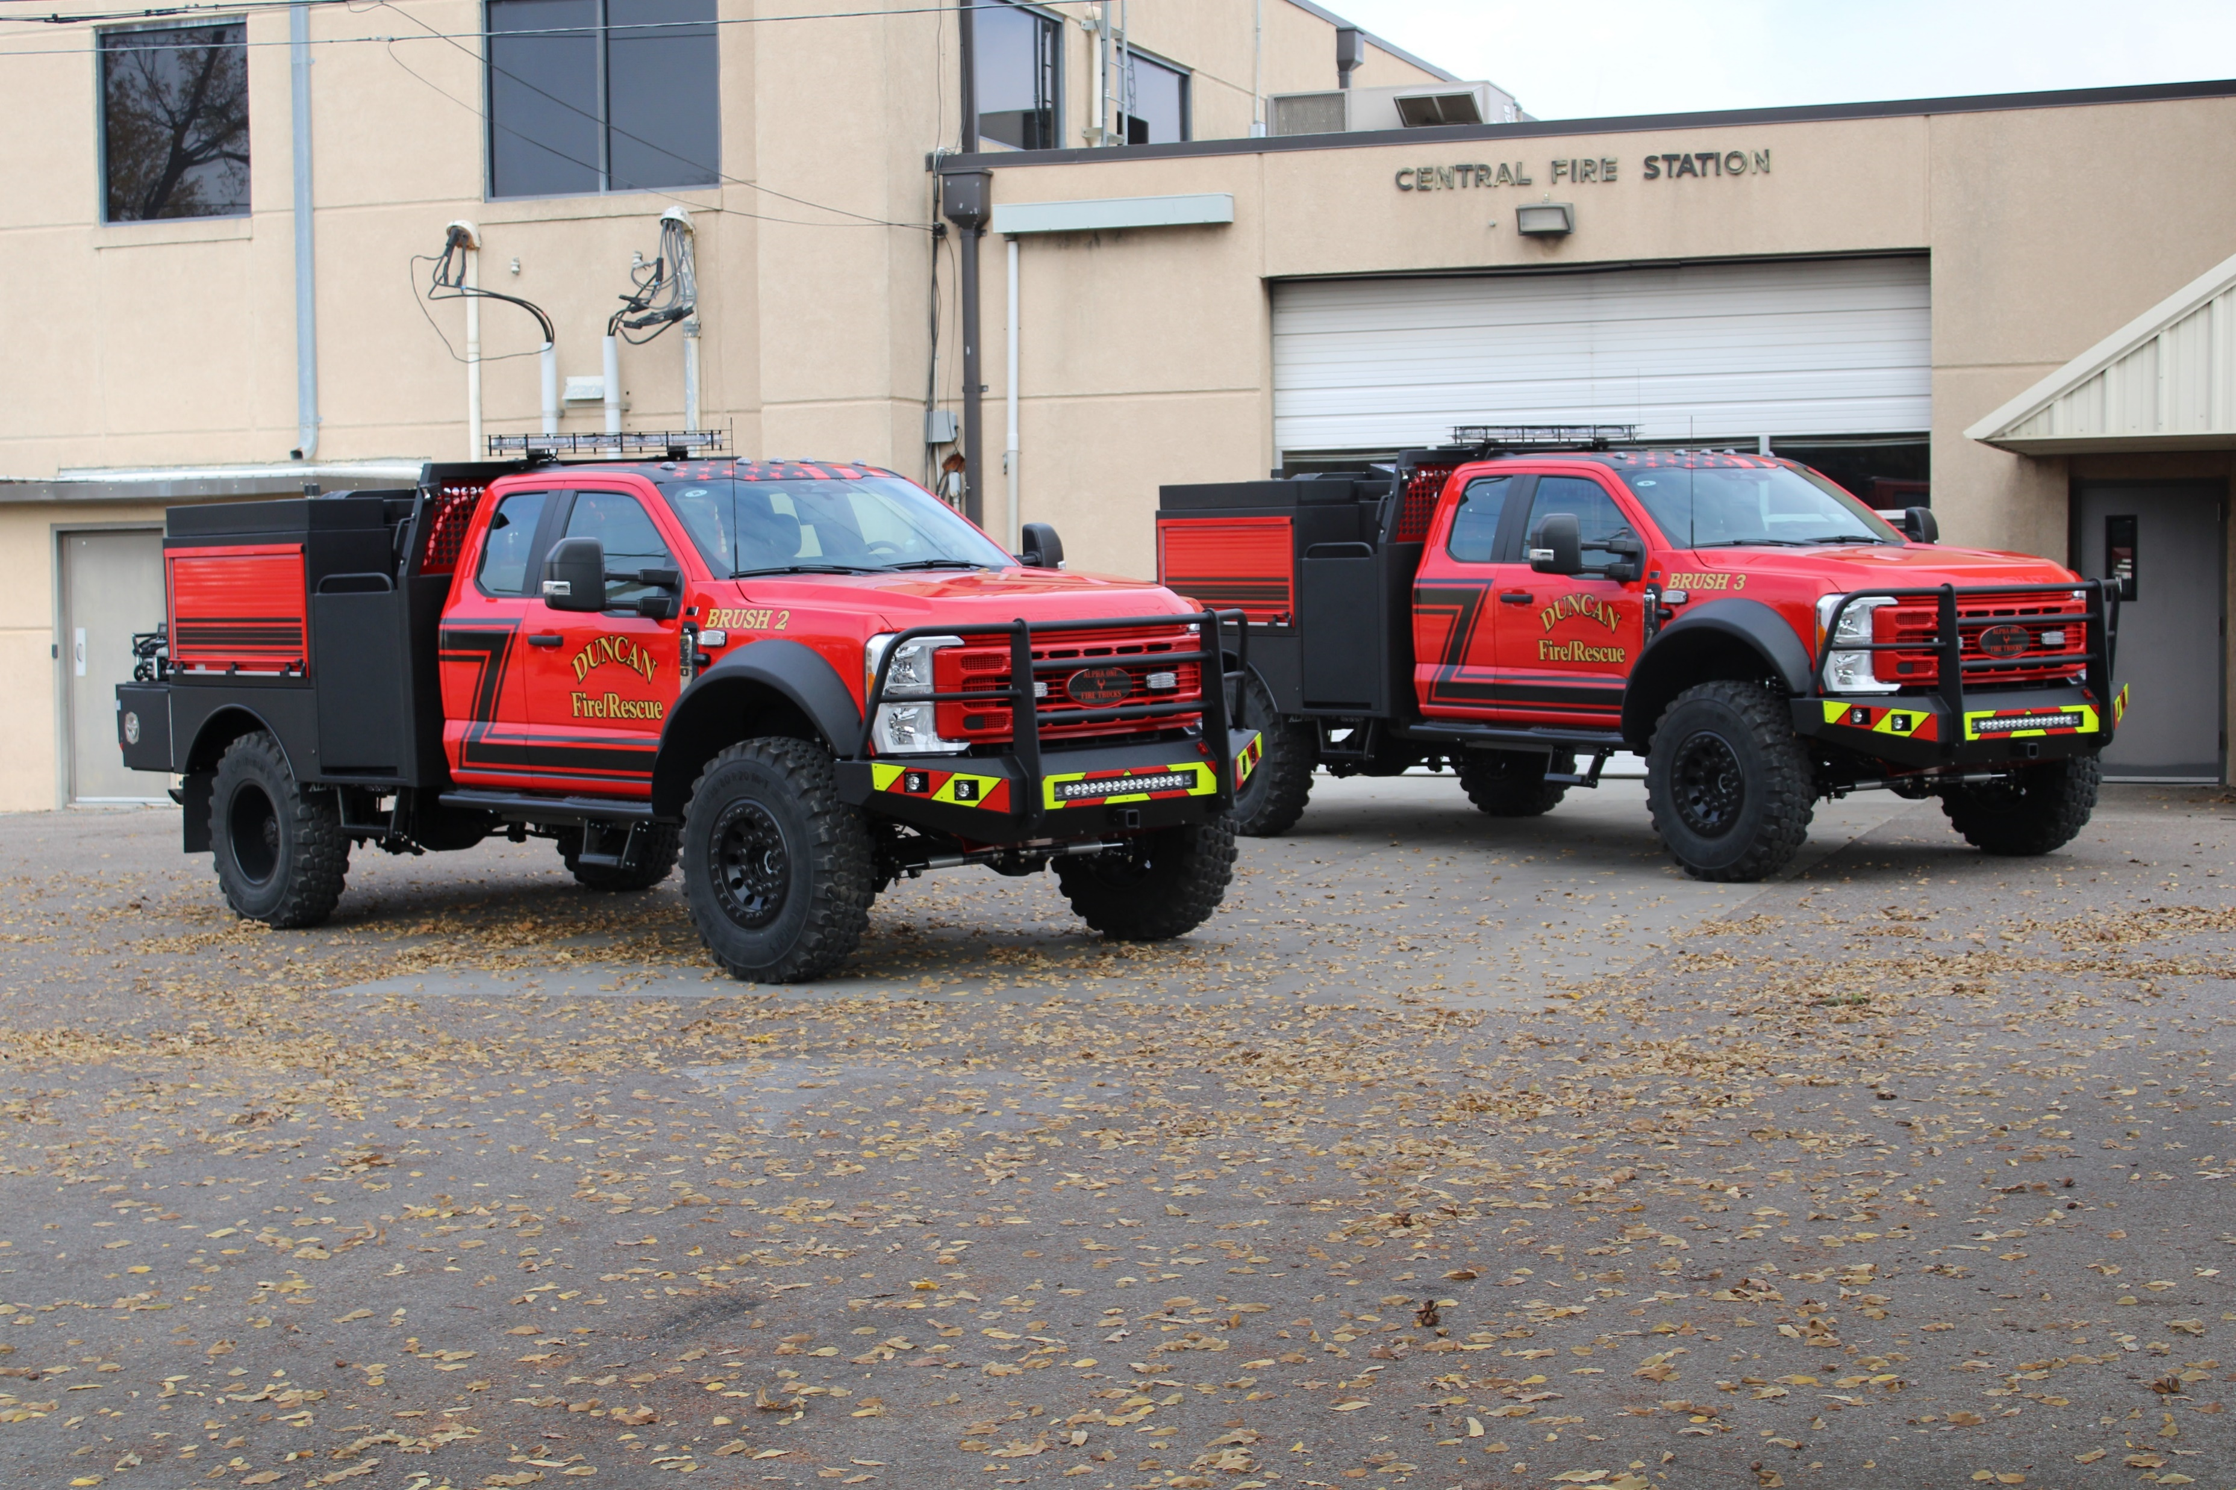
Public Facilities & Safety
What You Said
Strength: Low Crime Rates
Weakness: Dark Streets
Weakness: Lack of Awareness about “Reverse 911” Calls
Weakness: Vicious Dog Problems
Opportunity: Reinvest in Existing Facilities
“When we start including the higher aspirations of community into the mix; comfort, conviviality, beauty and fund, we begin to make places that are beyond merely livable and may ultimately be lovable.”
- Peter Kageyama

Slide 7
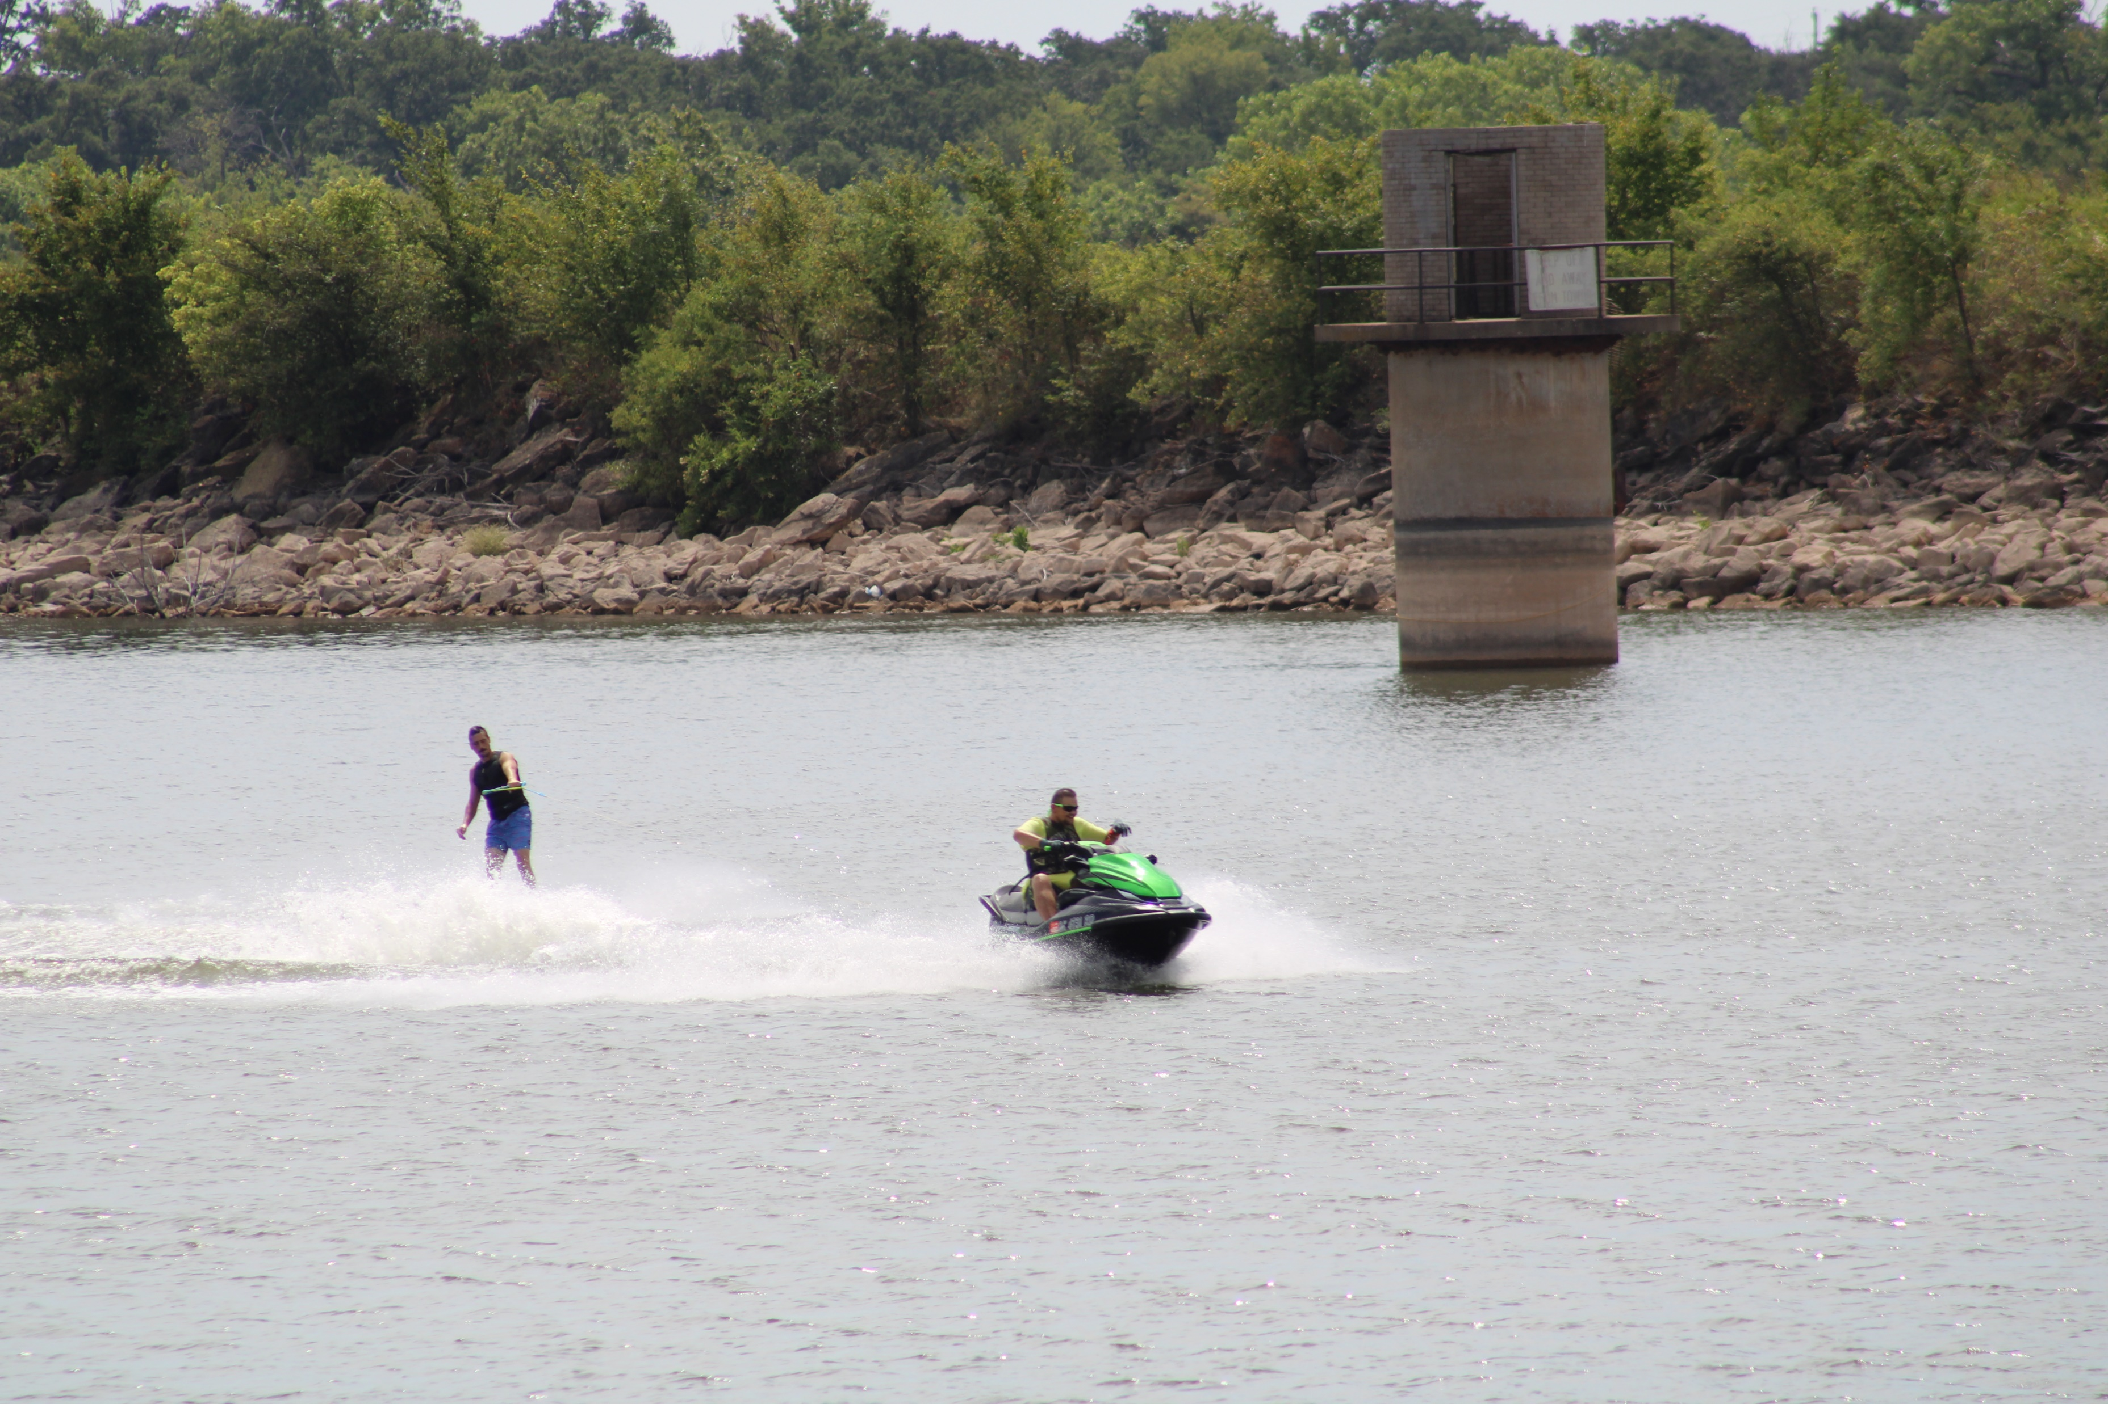
Recreation & Environment
What You Said
Strength: Kiddie Land/Fuqua Park
Strength: Simmons Center
Strength: Lakes/Recreation
Strength: DSPAC
Strength: DETA/Beautification
Weakness: Aging Facilities – Simmons Center
Weakness: Aging Facilities – Pool and Splash Pads
Opportunity: Parks
Opportunity: Lakes
Opportunity: Trails and Sidewalks
Opportunity: Main Street Pocket Park
Opportunity: Amphitheater
“If you watch a game, it’s fun. If you play it, it’s recreation. If you work at it, it’s golf.”
- Bob Hope

Slide 8
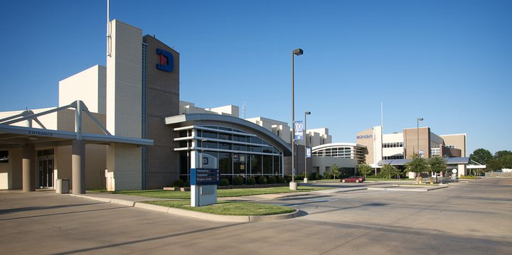
Health & Nutrition
What You Said
Strength: Duncan Regional Hospital
Weakness: 60% School Children on Reduced/Free Lunch Program
Weakness: Opioid Impact on Working Population
Weakness: Limited Behavioral Mental Health Services
Weakness: No Pharmacy on East Side
Weakness: No Grocery Store on East Side
Threat: Drugs
Threat: “Babies Having Babies”
Photo from DRH Facebook Page
“The doctor of the future will give no medicine, but will instruct his patients in care of the human frame, in diet, and in the cause and prevention of disease.”
- Thomas Edison

Slide 9



Education
What You Said
Strength: Duncan Public School System (Pre-K thru 12)
Strength: Library
Strength: Gabriel's House
Strength: Red River Technology Center
Strength: Cameron University
Strength: Beautiful Day
Weakness: No Library Annex on East Side
“Learn from yesterday, live for today, hope for tomorrow. The important thing is not to stop questioning.”
- Albert Einstein

Slide 10
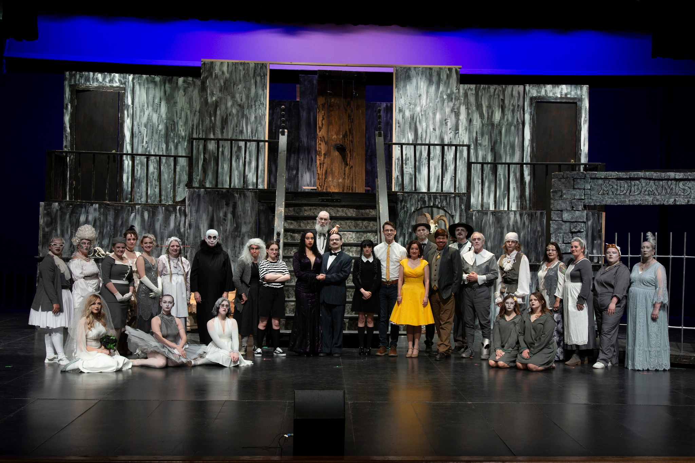
Arts & Culture
What You Said
Strength: Arts/Museums
Strength: Chisholm Trail Arts Council
Strength: Community Band Concerts
Strength: Chickasaw Nation
Weakness: Lack of Volunteers
Opportunity: Murals and Outdoor Art
Opportunity: Art Displays
Opportunity: Parades and Festivals
Photo from DLT Facebook Page
“Culture is the sum of all forms of art, of love, and of thought, which, in the course of centuries, have enabled man to be less enslaved.”
- André Malraux

Slide 11
Economic Development
What You Said
Strength: Business and Growth Opportunities
Strength: Proximity to Larger Markets
Strength: DAEDF
Strength: Chamber of Commerce
Strength: Low Taxes/Opportunity
Weakness: Bond Issues (Need Education)
Weakness: Need for Competitive Pay for Non-Skilled Workers
Weakness: Lack of Competitive Employment Opportunities
Weakness: Lack of Quality Restaurants
Opportunity: Downtown District
Opportunity: Citywide WiFi
Threat: Businesses Fighting for Same Funds
Threat: Low Investment/Reinvestment
“Government doesn’t create jobs, it only creates the conditions that make jobs more or less likely.”
- Mitch Daniels

Slide 12
Miscellaneous Topics
What You Said
Strength: Leadership
Strength: Humane Society
Strength: Think Ability
Strength: Douglass Center
Strength: McCasland Foundation
Weakness: Lack of Publicity
Weakness: Lack of Community Gateways
Weakness: Lack of Recycle Center
Opportunity: Community Billboard/Marque
Opportunity: Crapemyrtle Capital of OK
Opportunity: Ability to Increase Circulation of Local Dollars
Threat: We Wait for Others to Create Opportunities
Threat: Non-Profits are Fighting for Same Available Funding
Threat: Apathy
“Volunteering is the ultimate exercise in democracy. You vote in elections once a year, but when you volunteer, you vote every day about the kind of community you want to live in.”
- Author Unknown

Slide 13
Future Meetings
February 26, 2024
March 25, 2024
April 22, 2024
May 20, 2024 (3rd Monday)
June 24, 2024
July 22, 2024
August 26, 2024
September 23, 2024
October 28, 2024
November 18, 2024 (3rd Monday)
December 16, 2024 (3rd Monday)
“The creative process involves getting input, making recommendation, getting critical review, getting more input, improving the recommendation, getting more critical review… again and again and again.”
- Author Unknown

Slide 14

Thank you for sharing your input and visions for our future!
Nate Schacht, Director
Community Development
City of Duncan, Oklahoma
580-251-7715
nschacht@duncanok.gov

