Slide 1

Quality of Life Plan
Seeking Citizen Input and Visions for Our Future
Monday, May 20, 2024

Slide 2

Duncan Heart & soul
Updates
“We believe the strength of every community lies in the hands and hearts of the people who live there.”
- Duncan Heart and Soul

Slide 3
Recap
April 22, 2024
Categories Discussed
Public Facilities & Safety
Recreation & Environment
Health & Nutrition
Education
General Information Provided
Some categories will need to be expanded into new categories
Several items were discussed that will need additional research by staff
General information that will be used to establish future goals and objectives
Key players were shared that should be involved with the future planning process
“Data are just summaries of thousands of stories – tell a few of those stories to help make the date meaningful.”
- Dan Heath

Slide 4
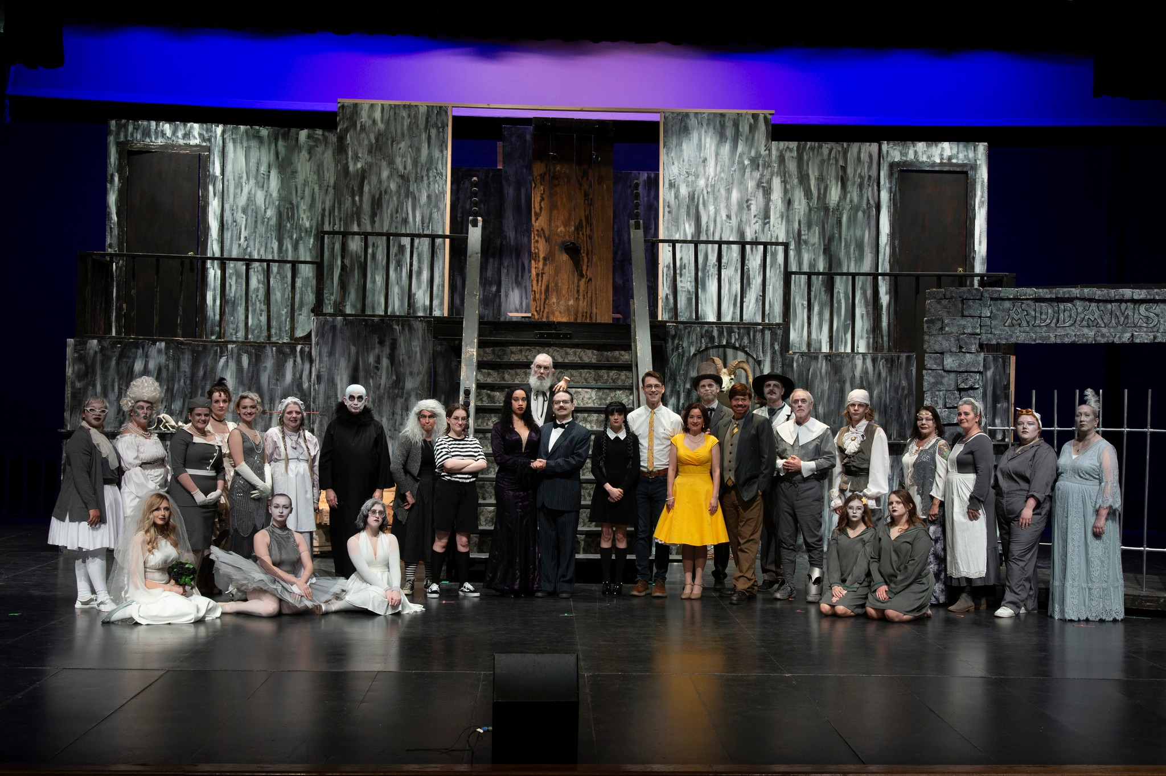
Arts & Culture
What You Said
Strength: Arts/Museums
Strength: Chisholm Trail Arts Council
Strength: Community Band Concerts
Strength: Chickasaw Nation
Weakness: Lack of Volunteers
Opportunity: Murals and Outdoor Art
Opportunity: Art Displays
Opportunity: Parades and Festivals
Photo from DLT Facebook Page
“Culture is the sum of all forms of art, of love, and of thought, which, in the course of centuries, have enabled man to be less enslaved.”
- André Malraux

Slide 5
Economic Development
What You Said
Strength: Business and Growth Opportunities
Strength: Proximity to Larger Markets
Strength: DAEDF
Strength: Chamber of Commerce
Strength: Low Taxes/Opportunity
Weakness: Bond Issues (Need Education)
Weakness: Need for Competitive Pay for Non-Skilled Workers
Weakness: Lack of Competitive Employment Opportunities
Weakness: Lack of Quality Restaurants
Opportunity: Downtown District
Opportunity: Citywide WiFi
Threat: Businesses Fighting for Same Funds
Threat: Low Investment/Reinvestment
“Government doesn’t create jobs, it only creates the conditions that make jobs more or less likely.”
- Mitch Daniels

Slide 6
Social Services
What You Said
Strength: Beautiful Day
Strength: Delta Community Action
Strength: 80+ Non-Profit Organizations
Strength: Think Ability
Strength: Gabriel’s House
Weakness: 60% Free/Reduced Meals at Schools
Weakness: Opioid Impact in Community
Weakness: Homelessness
Weakness: Behavior/Mental Health
Threat: Drug Use
Threat: Babies Having Babies
Threat: Apathy
“Not all of us can do great things, but we can do small things with great love.”
- Mother Teresa

Slide 7
Miscellaneous Topics
What You Said
Strength: Leadership
Strength: Humane Society
Strength: Think Ability
Strength: Douglass Center
Strength: McCasland Foundation
Weakness: Lack of Publicity
Weakness: Lack of Community Gateways
Weakness: Lack of Recycle Center
Opportunity: Community Billboard/Marque
Opportunity: Crapemyrtle Capital of OK
Opportunity: Ability to Increase Circulation of Local Dollars
Threat: We Wait for Others to Create Opportunities
Threat: Non-Profits are Fighting for Same Available Funding
Threat: Apathy
“Volunteering is the ultimate exercise in democracy. You vote in elections once a year, but when you volunteer, you vote every day about the kind of community you want to live in.”
- Author Unknown

Slide 8
Next Steps to move
Duncan forward
Establish Goal Statements
Your input will be used to create several “Goal Statements” that we will consider, modify, select that will be used to drive the various topics of this Quality of Life Plan.
Identify Objectives
Using the selected “Goal Statements” we will use additional citizen input to establish the first set of “Objectives” that will help guide policies and programs.
Identify Key Players and Stakeholders
Through citizen input, we will identify the “Key Players and Stakeholders” as those individuals/organizations that need to participate with the planning process.
Discuss Potential Funding Opportunities
Citizen discussion will drive pursuit of “Potential Funding” that may exist. These may include grants, fundraising, and use of tax dollars.
“Progress is impossible without change.”
- Walt Disney

Slide 9
Future Meetings
February 26, 2024
March 25, 2024
April 22, 2024
May 20, 2024 (3rd Monday)
June 24, 2024
July 22, 2024
August 26, 2024
September 23, 2024
October 28, 2024
November 18, 2024 (3rd Monday)
December 16, 2024 (3rd Monday)
“The creative process involves getting input, making recommendation, getting critical review, getting more input, improving the recommendation, getting more critical review… again and again and again.”
- Author Unknown

Slide 10

Thank you for sharing your input and visions for our future!
Nate Schacht, Director
Community Development
City of Duncan, Oklahoma
580-251-7715
nschacht@duncanok.gov

