Slide 1

Quality of Life Plan
Seeking Citizen Input and Visions for Our Future
Monday, October 28, 2024

Slide 2

Duncan Heart & soul Updates
“We believe the strength of every community lies in the hands and hearts of the people who live there.”
- Duncan Heart and Soul
What do you LOVE about Duncan?
Why does this matter to YOUU?
How can this improve the quality of life in Duncan?
What do you wish we had in Duncan?
Why do you wish we had it?
How will that impact the quality of life in Duncan?
What do you want to see in the future?
Why would you like to see it?
How do you think that would improve the quality of life in Duncan?

Slide 3
Recap September 23, 2024
Duncan Heart and Soul
Ward meetings have been completed – looking to establish Ward Ambassadors to serve as community liaisons
Beginning next phase – story telling and gathering
Parks and Recreation
Aquatic Center – partnership with City, DPS, and Simmons Center
Lake improvements and equipment rentals
ADA improvements – access to equipment and locations
Community gardens, beautification, and landscaping
Environment
Hwy 81 is alternative fuel corridor
Prioritize energy production and use
Address energy consumption of crypto-currency
Promote wildflower designation
Become Tree City, Butterfly Community
Work with OSU and DPS on education/stewardship
“Those who tell the stories rule the world.”
- Hopi American Indian Proverb

Slide 4
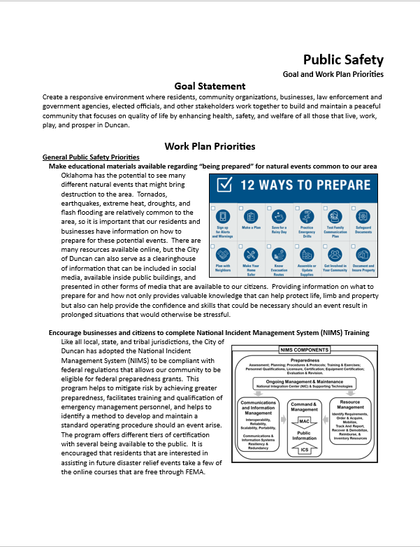
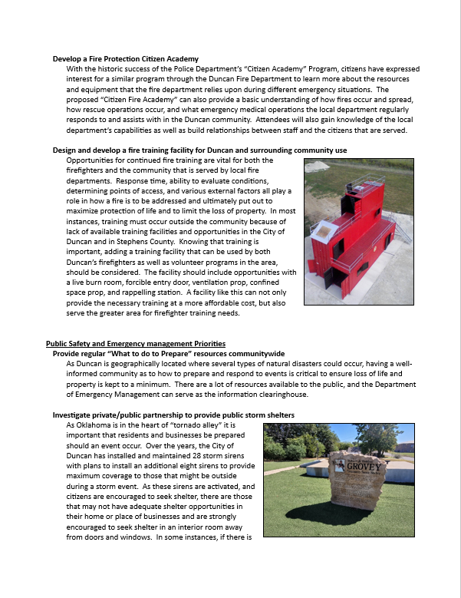
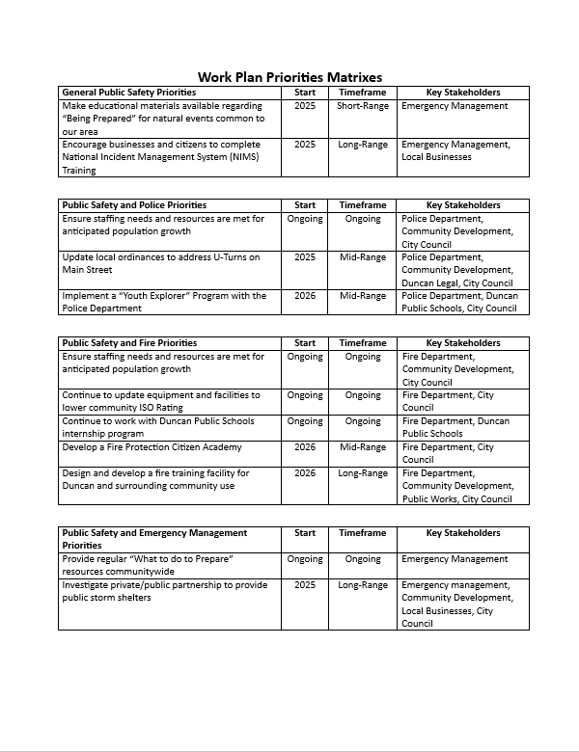
Draft version

Slide 5
Social Services
Social Services Categories
Administration and Management
Advocacy and Community Organizing
Aging Advocacy
Child Care and Welfare
Developmental Disabilities
Financial Assistance Services
Food and Nutrition Programs
Health Care
International Social Work
Justice and Corrections
Mental health and Clinical Social Work
Mental Health and Substance Use
Strive to be a community known for safeguarding the well-being of children, supporting and protecting vulnerable older adults and persons with disabilities, improve mental health therapy and wellness, and committing to diversity, equity and inclusion while being committed to continuous quality improvement.

Slide 6
Social services
Objectives to Consider:
Safeguarding the well-being of children – create safe environments, promote communication, identify risks, intervention practices, proper reporting systems, involve children in decisions.
Protect vulnerable older adults and persons with disabilities – advocate for equal opportunities, create opportunities for success, provide local support system, and advocate and empower this group.
Improve mental health communitywide – educate to understand and reduce stigma, raise awareness and implement early screening/detection, encourage physical activity, and encourage social opportunities and activities.
Strive to be a community known for safeguarding the well-being of children, supporting and protecting vulnerable older adults and persons with disabilities, improve mental health therapy and wellness, and committing to diversity, equity and inclusion while being committed to continuous quality improvement.

Slide 7
Health and nutrition
Health Programs and Initiatives:
Addiction Medicine
Behavior Health
Birth Center
Cancer Care
Cardiovascular
Ear, Nose & Throat
Family Medicine
Home Care
Imaging
Intervention Pain
Orthopedics
Pulmonology
Sleep Center
Women’s Health
Nutrition Needs and Concerns:
Identified and designated food deserts
Growing neighborhood poverty levels
Low-access to quality, healthy foods
Food insecurity – limited access to the nutrition for active, healthy living
Foster innovative partnership to ensure all community members have access to health, nutrition, wellness, and family strengthening resources while addressing health inequities through education, healthcare access, and advocate to improve the overall physical health, mental health, and wellness of the community.

Slide 8
Health and nutrition
Objectives to Consider:
Improve communitywide access to health, nutrition and wellness – use of telemedicine, mobile health units, education and outreach.
Address food deserts that are occurring throughout the community – households impacted by poverty and/or lack of transportation, poor diet options and high-calorie foods only available, food insecurity for active and healthy living.
Programs that educate citizens on physical and mental health – reduce stigma, raise awareness, and provide opportunities for activity and engagement.
Ways to advocate on behalf of the community to improve health and wellness – physical activity, nutrition education, tobacco control, mental health awareness, safe communities, clean air and water.
Address housing stability, food security, financial literacy, and employment opportunities.
Foster innovative partnership to ensure all community members have access to health, nutrition, wellness, and family strengthening resources while addressing health inequities through education, healthcare access, and advocate to improve the overall physical health, mental health, and wellness of the community.

Slide 9
Next Steps to move Duncan forward
Upcoming Meetings
November: Economic Development, Education
December: Arts & Culture, Neighborhood Engagement, Housing
First Drafts Completed
Transportation
Alternative Transportation
Infrastructure
Public Facilities
Public Safety
Rough Drafts in Progress
Parks and Recreation
Environment
January 2025 Goal
Presentation to Planning Commission – January 21, 2025
Presentation to City Council – January 28, 2025
“Looking back isn’t going to help you. Moving forward is the thing you have to do.”
- McKayla Maroney

Slide 10
Future Meetings
February 26, 2024
March 25, 2024
April 22, 2024
May 20, 2024 (3rd Monday)
June 24, 2024
July 22, 2024
August 26, 2024
September 23, 2024
October 28, 2024
November 18, 2024 (3rd Monday)
December 16, 2024 (3rd Monday)
“The creative process involves getting input, making recommendation, getting critical review, getting more input, improving the recommendation, getting more critical review… again and again and again.”
- Author Unknown

Slide 11

Thank you for sharing your input and visions for our future!
Nate Schacht, Director
Community Development
City of Duncan, Oklahoma
580-251-7715
nschacht@duncanok.gov

