Slide 1

Destination Duncan: A Quality-of-Life Plan 2025 – The Journey Begins for a Better Duncan!

Slide 2
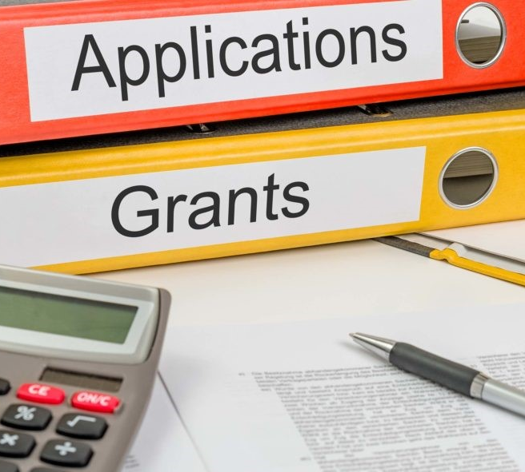
Grant Applications
Submitted:
TSET Legacy Grant ($10m) – Funds were not allocated to Duncan for Abe Raizen Park
In Progress:
ODOT TAP Grants – seeking 80/20 funding for sidewalks along Hwy 81 (Elk Ave to Library)
Researching:
American Academy of Dermatology (shade structures for Abe Raizen soccer fields)

Slide 3
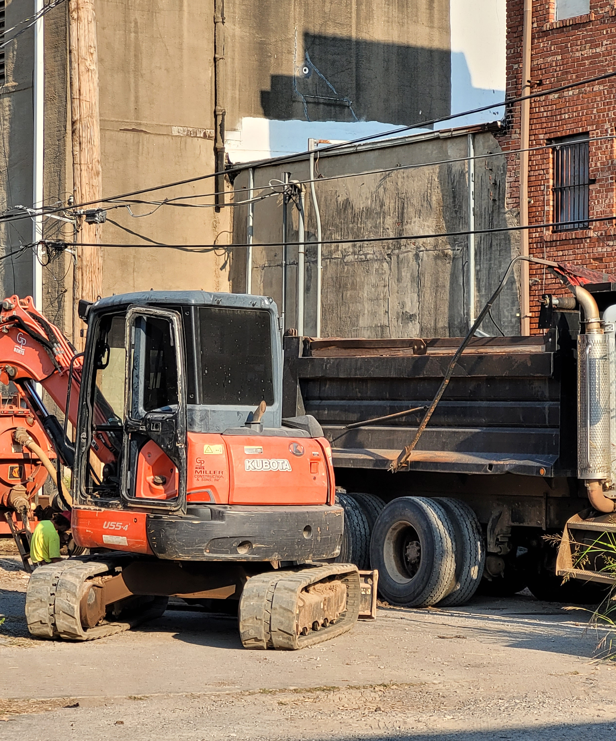
Infrastructure

Slide 4
You and I come by road or rail, but economists travel on infrastructure.
Street Lighting Improvement Project
Parts and new lights have been ordered for repairs to existing streetlights
Street lighting upgrades proposed for Main Street
Waste Water Treatment Facility Projects
During the spring rains/flooding, outfall infrastructure was damaged
DEQ requirements for repairs will cost (estimated) $2.2 million
Water Tank & Tower Inspections and Painting
Inspections will occur in 2025/26 and cost approximately $200,000
$1 million has been proposed for the 2026 budget to perform maintenance and repairs based on inspections and fund repainting of tanks and towers
Road Repairs and Re-Asphalting
2024 saw 125 blocks resurfaced; 2025 only ten blocks
Limited resurfacing due to reallocating funds to address storm damage from spring rains and flooding in other critical infrastructure areas

Slide 5
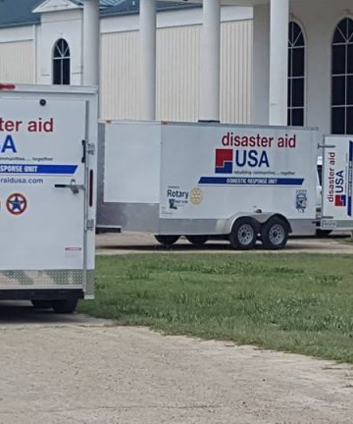
Public Safety

Slide 6
Do your best. One day you will be someone’s hero.
Fire Station #4 (Camelback & Hwy 81)
Architect has released documents for bids to contractors
Road Restriping Project
Public Works received bids to do multiple road restriping projects
Estimated 24.5 miles of restriping proposed (including Elk Avenue by the hospital)
Cost for the entire project will be approximately $186,000.00 ($7,591.84 per mile)
Disaster Aid USA
Program started with a Rotary Club wanting to provide humanitarian aid when domestic disasters strike
Duncan Rotary Club will be learning more about the program and potentially looking at housing equipment for the region in Duncan, Oklahoma
Currently Oklahoma does not have equipment housed in the state for Disaster Aid USA

Slide 7
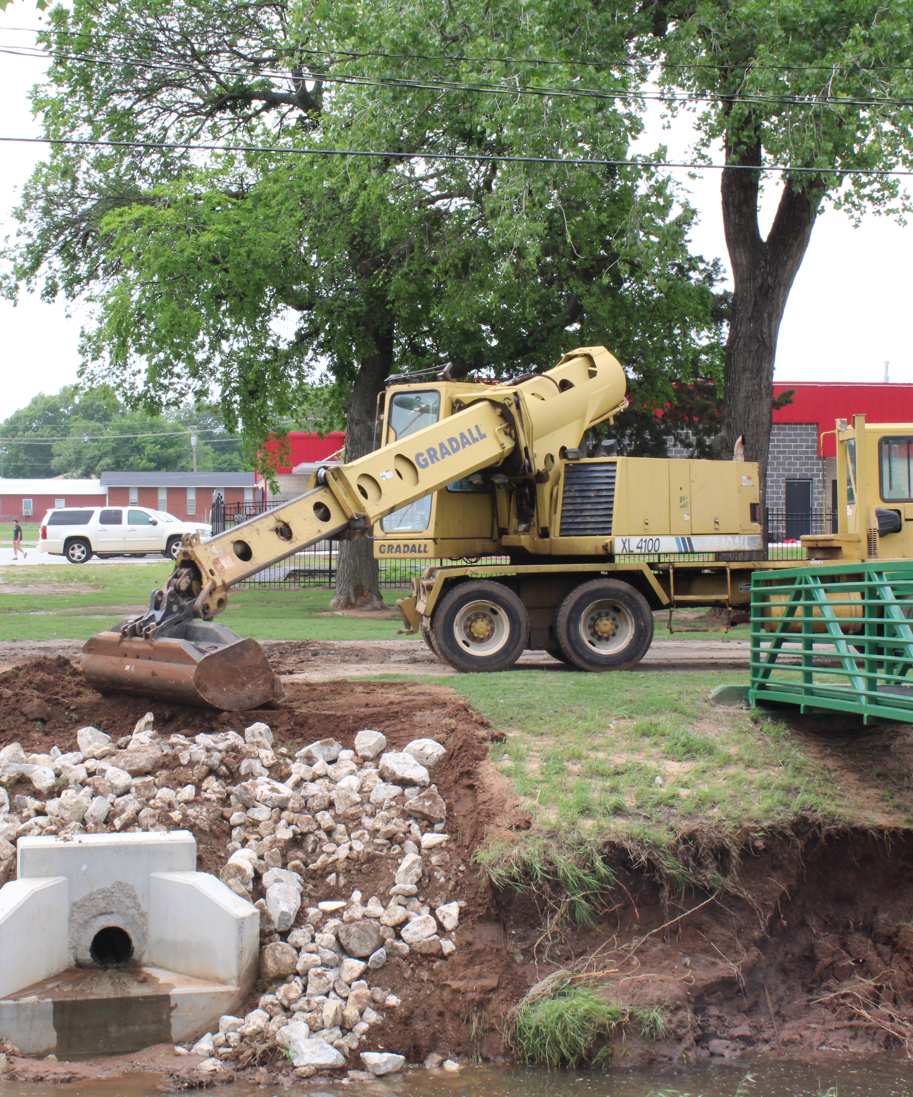
Environment

Slide 8
Nature holds the key to our aesthetic, intellectual, cognitive and even spiritual satisfaction.
Floodplain Administration
Community Development continues to work with FEMA regarding past construction that occurred within designated floodplain areas – engineering firm has been hired to calculate impacts of these developments and impacts to upstream and downstream rates of flow
Green Technology and Infrastructure
Duncan submitted ideas for the ODOT Plan to make Hwy 81 an EV Corridor with multiple charging stations
Staff is trying to identify public/private partnerships with existing businesses that could host EV charging stations
Tree City USA Initiative
Tree City USA communities allocate a minimum of $2 per capita towards community forestry (expenses for planting and maintaining trees)
Currently 24 Oklahoma communities are tree cities; 5 Oklahoma businesses are tree companies; and 10 colleges are tree campuses
Rotary is developing a plan for Duncan to become the next Tree City in Oklahoma

Slide 9
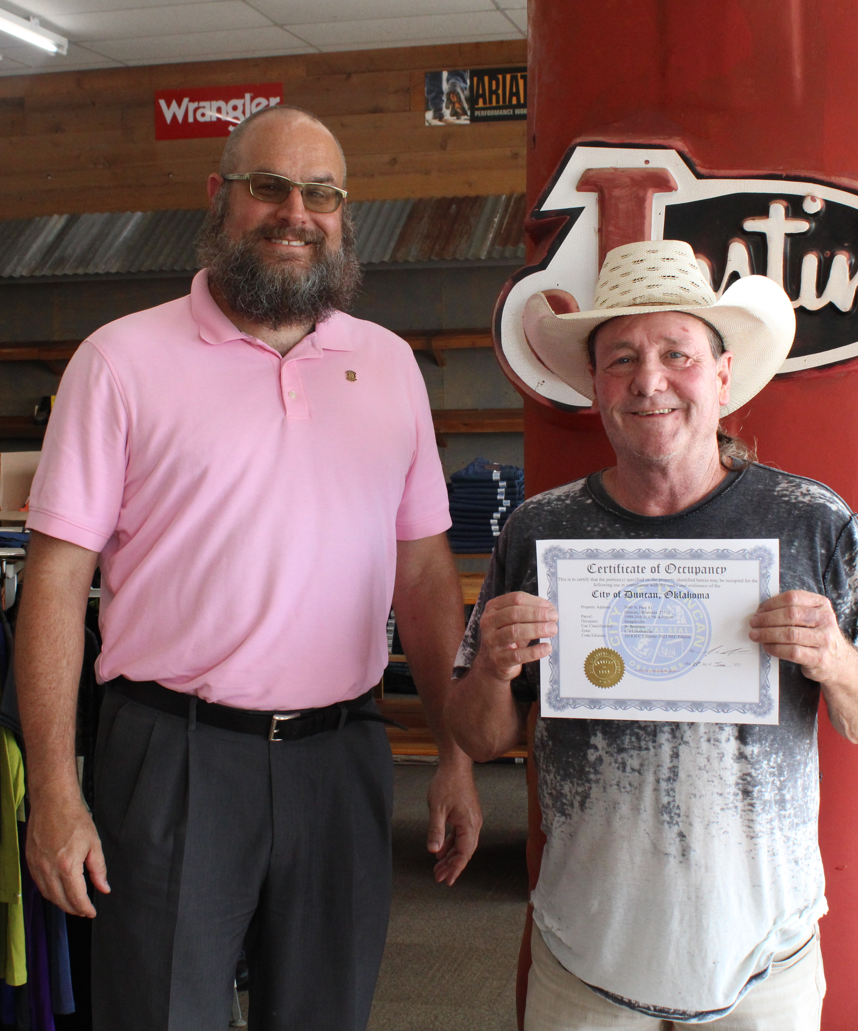
Economic Development

Slide 10
The path of Economic Development creates solutions that reduce poverty and creates opportunities for all!
Main Street Duncan – The Heart of the Community
Developing incentives to attract new business opportunities to Main Street
Collecting data points for Main Street Economic Vitality Plan
Implementing Placemaking Practices – Chickasaw Nation’s Planning Process
Opportunity and Enterprise Zones
Opportunity Zones use capital gains tax benefits to spur investment in troubled areas
Enterprise Zones offer a wide range of incentives and abatements to encourage private economic development
Community Development is working with the Oklahoma Department of Commerce to utilize programs to bring more economic opportunities to Duncan
Meetings with Retail Developers
Strong interest in Highway 81 Corridor for retail/restaurant developments
Discussions with individual commercial developers looking at Bypass potential

Slide 11

Updates: Ongoing Work Priorities

Slide 12
The Road to Progress!
Transportation:
ODOT Overpass at Elk and Bypass – projected completion date June 30, 2026
SORTPO Transportation Plan – Duncan submitted 100+ ideas for consideration
Health and Nutrition:
Dollar General Market is open – how it happened
DRH Project: ENT Facility west of Sanford Children’s Hospital
DRH Project: Orthopedic and Sports Medicine Clinic north of hospital
Call to Action – input needed for State Plan regarding Mental & Behavior Health
Arts and Culture:
October 3rd – Bob Wills’ Texas Playboys (CTAC Live Show at Simmons Center)
October 17-18 and 24-25 – Dessert Theatre (DLT event at 913 W Main Street)
November 22nd – Artrageous! (CTAC Live Show at Simmons Center)
December 5-6 and 12-13 – A Christmas Carol (DLT event at 913 W Main Street)
Housing:
Researching amendments to Zoning Codes for residential uses
Working with local contractors to prepare incentives for affordable housing
Working with developer looking at potential of 150 +/- new homes

Slide 13
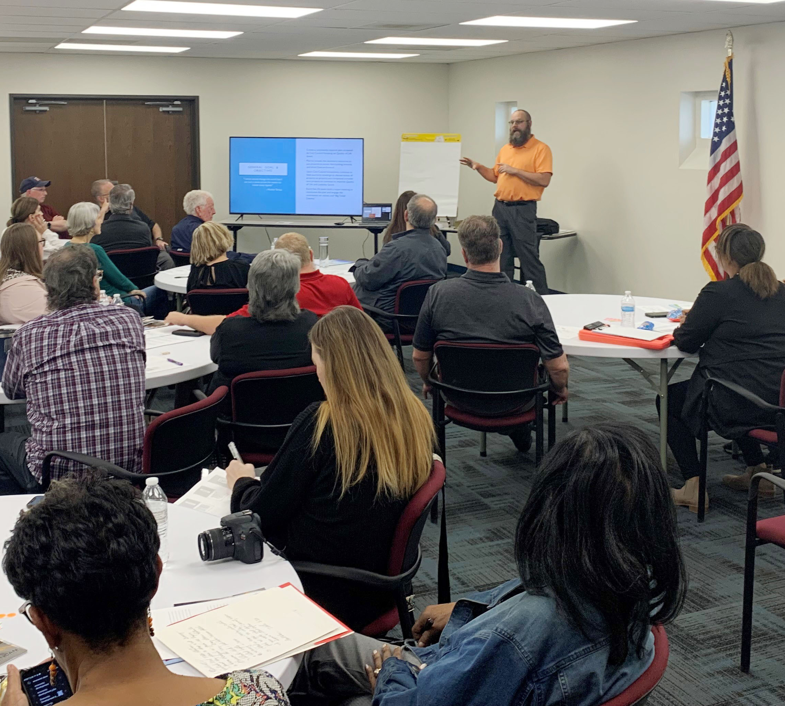
Upcoming Meetings & Discussions
March 24, 2025
June 23, 2025
September 22, 2025
December 15, 2025

Slide 14

Thank You for Sharing your Input and Visions for our Future!
Nate Schacht, Director
Community Development
City of Duncan, Oklahoma
580-251-7715
nschacht@duncanok.gov

