Slide 1

Quality of Life Plan
Seeking Citizen Input and Visions for Our Future
Monday, March 25, 2024

Slide 2

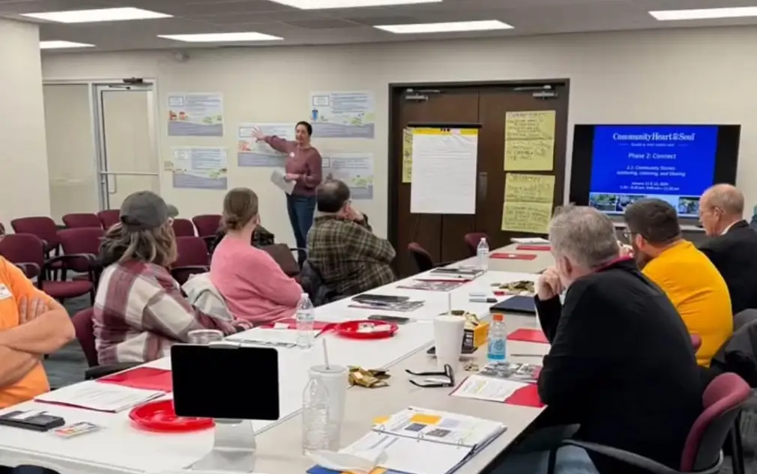
Duncan Heart & soul
Updates
Three Guiding Principals:
Involve Everyone
Focus on What Matters Most
Play the Long Game
“We believe the strength of every community lies in the hands and hearts of the people who live there.”
- Duncan Heart and Soul

Slide 3
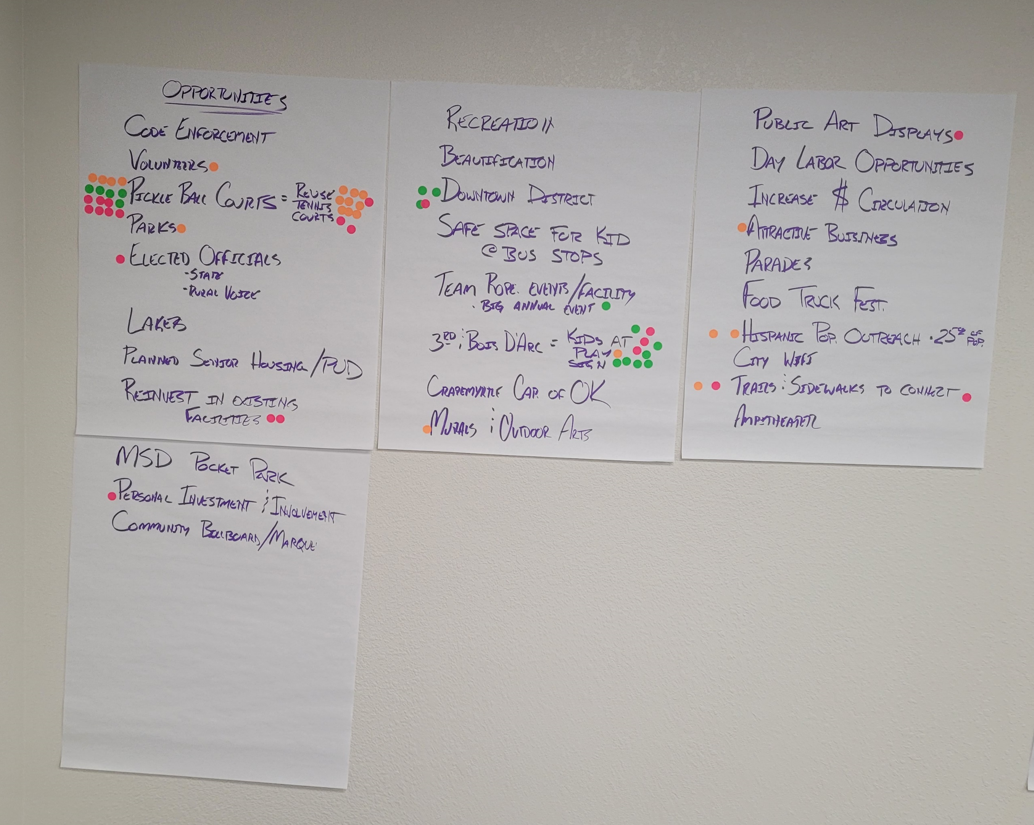
S.W.O.T. Analysis
Results
Your voice matters – City Officials met with citizens regarding traffic safety for areas where children play and STOP signs will be installed.
Your voice matters – City staff is looking at several grant opportunities that may provide funding to convert existing tennis courts into Pickleball courts.
Your voice matters – City staff is working with the Duncan Heart and Soul Team to hold meetings in different neighborhoods.
“Without continual growth and progress, such words as improvement, achievement, and success have no meaning.”
- Benjamin Franklin

Slide 4
S.W.O.T. Analysis
Results
Your voice matters – Duncan Power and Light is actively working on compiling the equipment and materials necessary to repair streetlights that have been damaged (more the replacing a lightbulb).
Your voice matters – City Officials have been gathering comparisons regarding utility rates of other neighboring communities and communities our size. Staff has quickly reviewed third-party data from BestPlaces.net and found:
Numbers less than 100% are less expensive
Numbers more than 100% are more expensive
“Without continual growth and progress, such words as improvement, achievement, and success have no meaning.”
- Benjamin Franklin
United States | 100.0%
Oklahoma | 99.7%
Duncan, OK | 98.5%
Ada, OK | 100.8%
Ardmore, OK | 99.4%
Jenks, OK | 98.0%
Marlow, OK | 98.5%
Chickasha, OK | 102.6%

Slide 5
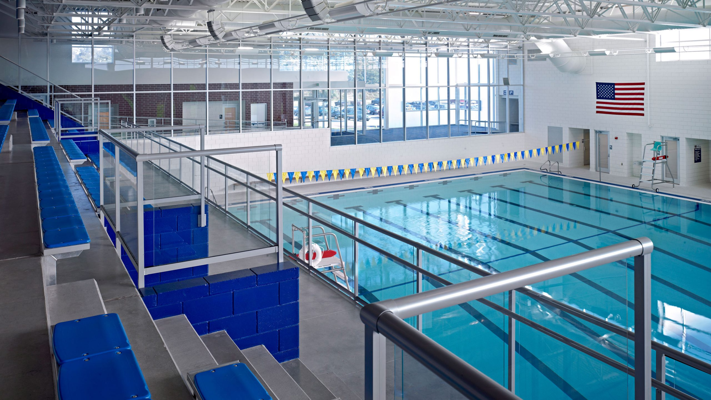
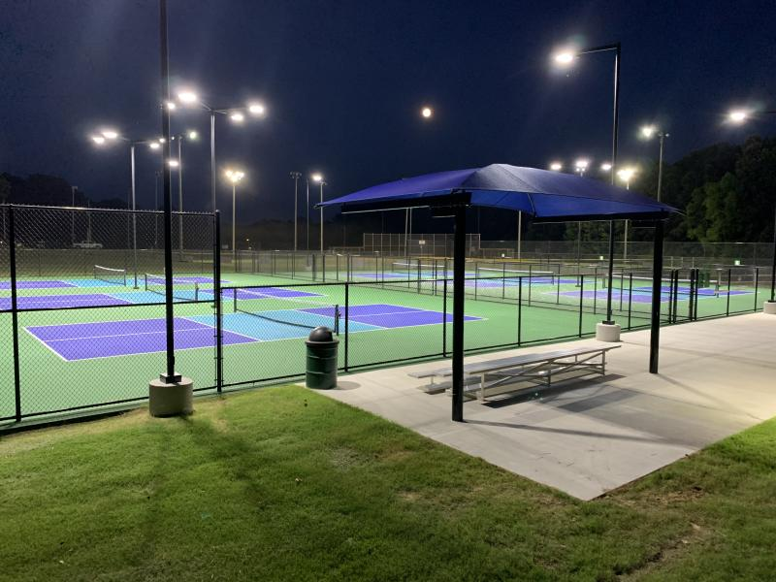
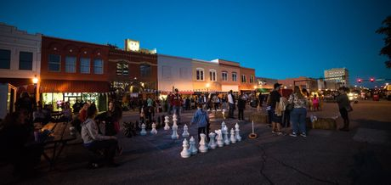
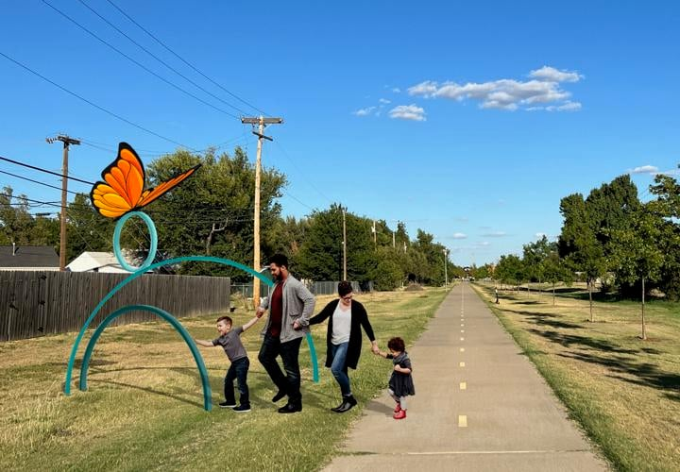
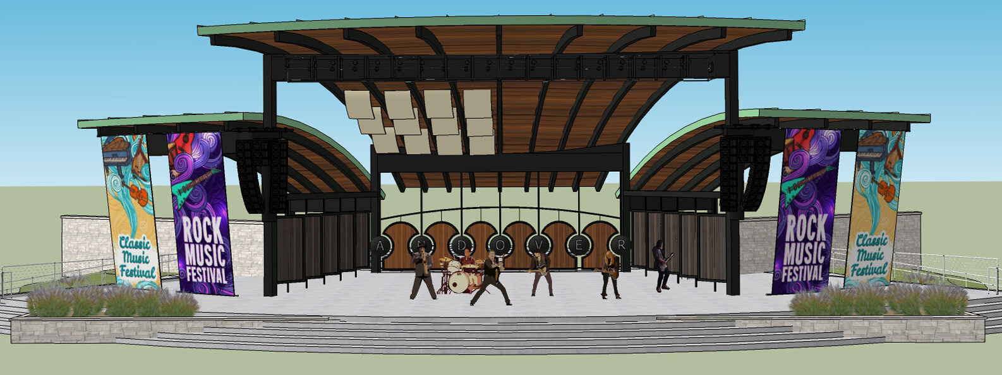
“Big Ticket Desires”
“Don’t give up on your dreams, or your dreams will give up on you.”
- John Wooden

Slide 6
Funding Opportunities for future projects
Ada, Oklahoma – “Penny for our City” Program (Quality of Life)
Oklahoma City, Oklahoma – MAPS Projects (Quality of Life)
Norman, Oklahoma – “Norman Forward” Program (Quality of Life)
Municipal Bonds for Infrastructure Improvements
Federal Grants – 50/50 and 80/20 require matches
Philanthropic Grants – matches encouraged and/or required
“This country will not be a good place for any of us to live in unless we make it a good place for all of us to live in.”
- Theodore Roosevelt

Slide 7
Housing
What You Said
Weakness: Homelessness
Weakness: Lack of Adequate Housing
Weakness: Housing Vouchers and Stipends
Weakness: Homeless Camps
Opportunity: Planned Senior Housing/PUD
Threat: Home Ownership
Threat: Affordable Housing vs Job Creation
What Data Says
AARP Scores indicate improvements in housing costs; housing cost burden; and availably of subsidized housing.
City of Duncan Data shows 30 new home starts with average cost of construction being $350,000 per home (3 year period)
Census Data shows 68.2% of homes are owner occupied
“One of the basic human rights is housing – the right not only to have a place to live, but to have it be your own.”
- Jimmy Carter

Slide 8
Neighborhood
Engagement & Opportunity
What You Said
Strength: Friendly Community
Strength: Rise Together in Times of Need
Strength: Family Feel
Strength: Churches
Weakness: Lack of Inclusion
Weakness: Accessible Public Meeting Times
Opportunity: Volunteers
Opportunity: Hispanic Population Outreach
Opportunity: Personal Investment and Involvement
Opportunity: Food Truck Festival
Opportunity: Parades
Threat: Not Taking Advantage of Programs and Opportunities
Threat: Missed Opportunities
“Imagine what our real neighborhoods would be like if each of us offered, as a matter of course, just one kind word to another person.”
- Mr. (Fred) Rodgers

Slide 9
Transportation
What You Said
Strength: Walking Trails
Weakness: Current Road Infrastructure and Aging Road Infrastructure
Weakness: Lack of Public Transit
Weakness: Lack of Sidewalks in Residential Areas
Weakness: Limited Access Points to Cross Town
Some Initial Steps Occurring
CDBG Grants for Road Improvements
City Adopted Road Conditions Study
Safe Routes to Schools Funding
Partnerships with ODOT
“In Copenhagen, there’s a long-term commitment to creating a well-functioning pedestrian city where all forms of movement – pedestrian, bicycles, cars, public transportation – are accommodated with equal priority.”
- Bjarke Ingels

Slide 10
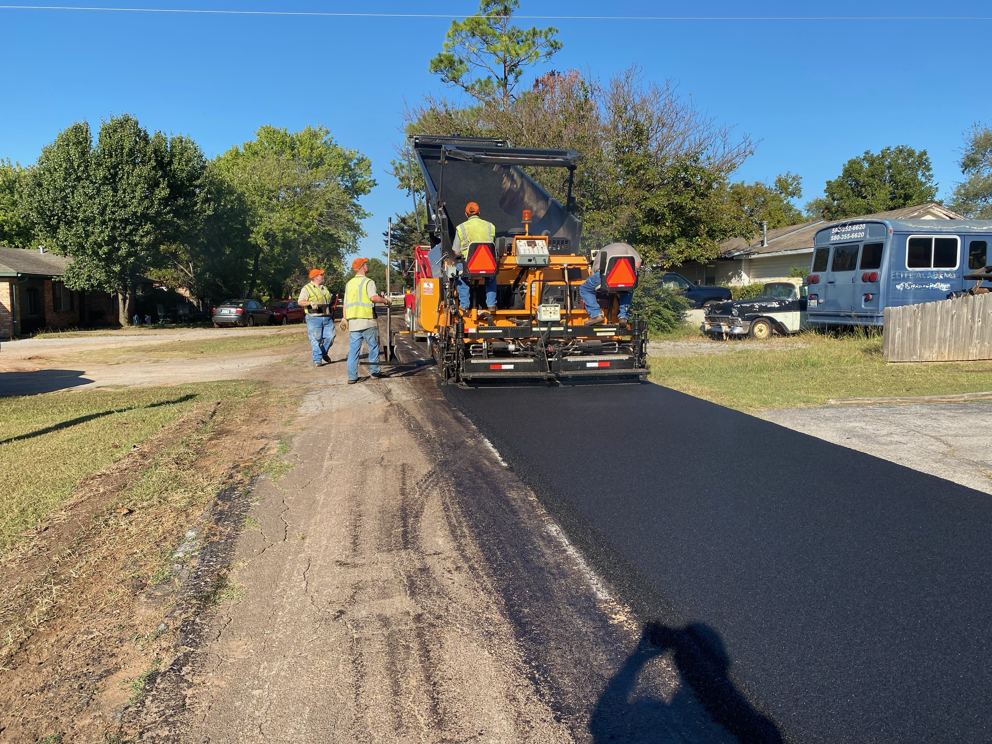
Infrastructure
What You Said
Weakness: Infrastructure – roads
Weakness: Infrastructure – water system
Weakness: Lack of Utility Choices
Opportunity: Reinvest in Existing Infrastructure
Threats: Utility Costs/Water Rates
Threats: Low Reinvestment Practices
“Infrastructure is the backbone of economic growth. It improves access to basic services such as clean water and electricity, creates jobs and boosts business.”
- Alok Sharma

Slide 11
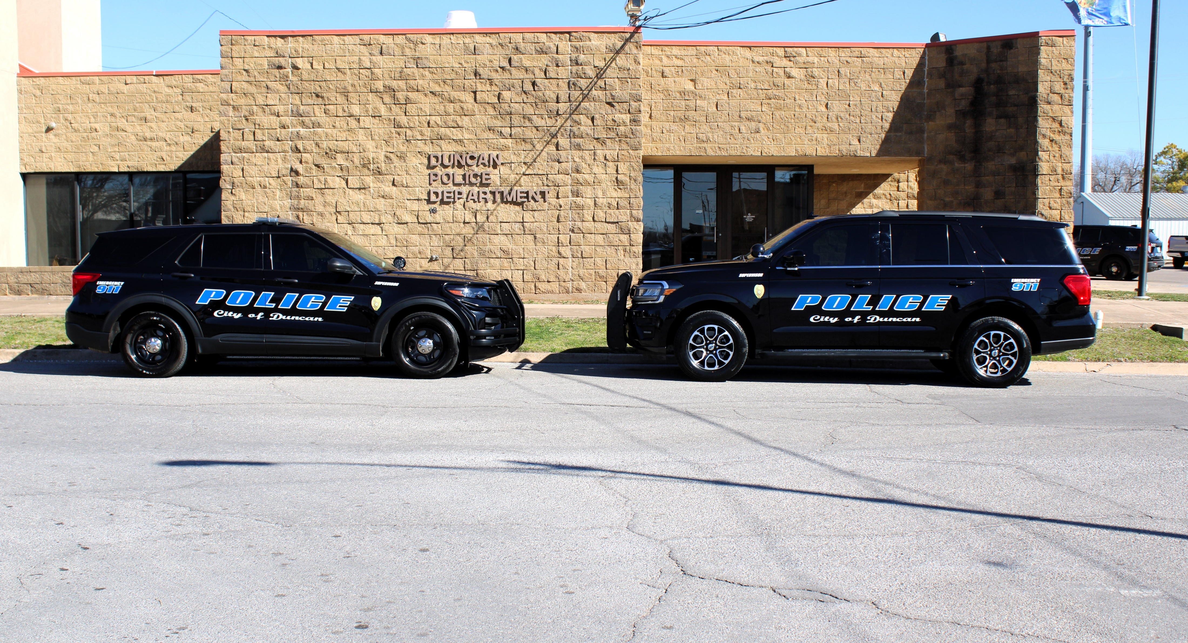
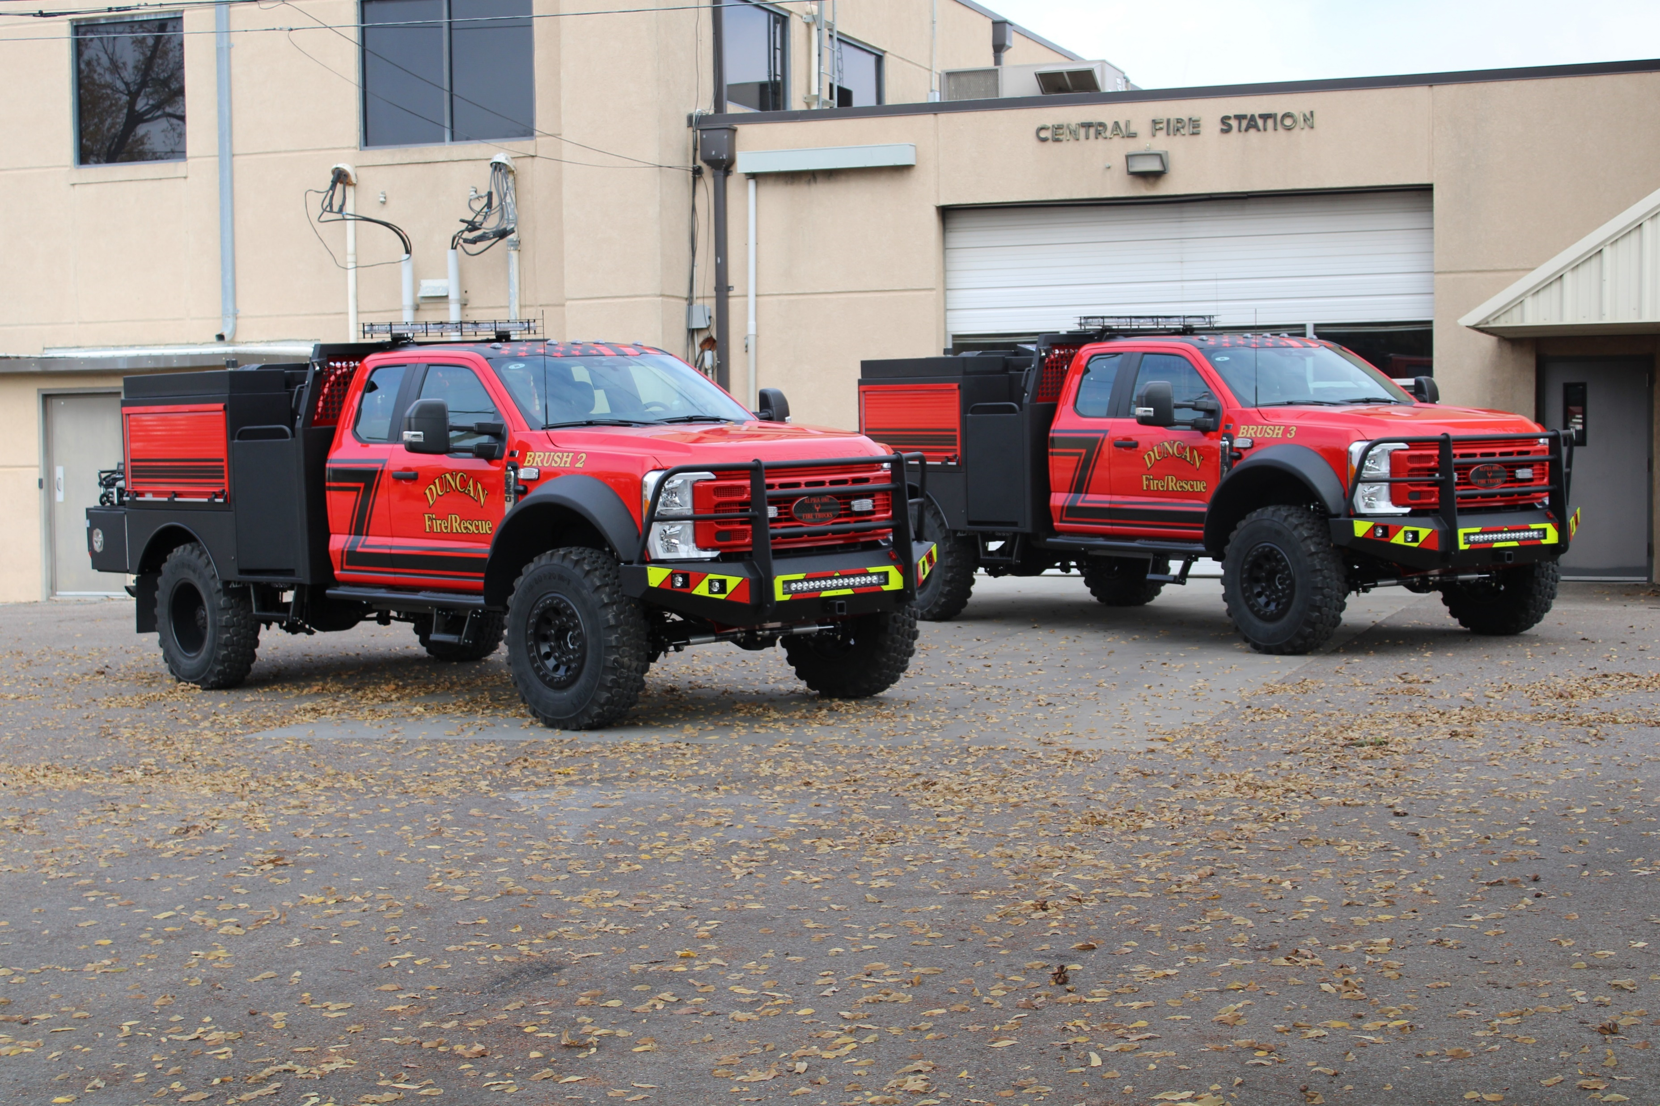
Public Facilities &
Safety
What You Said
Strength: Low Crime Rates
Weakness: Dark Streets
Weakness: Lack of Awareness about “Reverse 911” Calls
Weakness: Vicious Dog Problems
Opportunity: Reinvest in Existing Facilities
“When we start including the higher aspirations of community into the mix; comfort, conviviality, beauty and fund, we begin to make places that are beyond merely livable and may ultimately be lovable.”
- Peter Kageyama

Slide 12
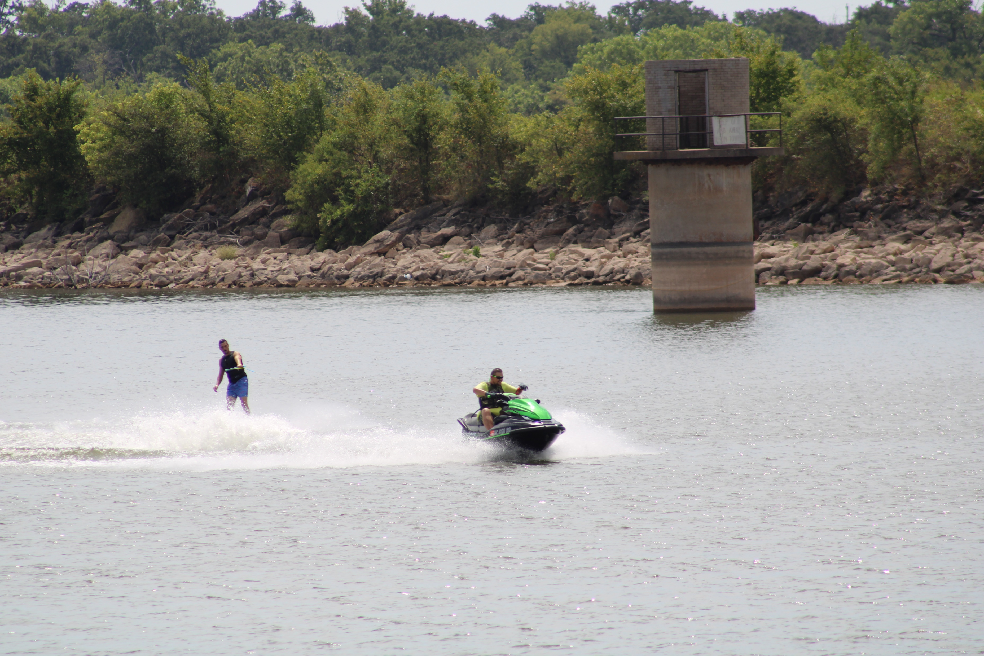
Recreation & Environment
What You Said
Strength: Kiddie Land/Fuqua Park
Strength: Simmons Center
Strength: Lakes/Recreation
Strength: DSPAC
Strength: DETA/Beautification
Weakness: Aging Facilities – Simmons Center
Weakness: Aging Facilities – Pool and Splash Pads
Opportunity: Parks
Opportunity: Lakes
Opportunity: Trails and Sidewalks
Opportunity: Main Street Pocket Park
Opportunity: Amphitheater
“If you watch a game, it’s fun. If you play it, it’s recreation. If you work at it, it’s golf.”
- Bob Hope

Slide 13
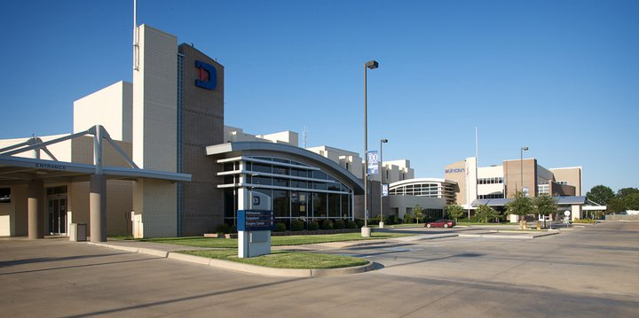
Health & Nutrition
What You Said
Strength: Duncan Regional Hospital
Weakness: 60% School Children on Reduced/Free Lunch Program
Weakness: Opioid Impact on Working Population
Weakness: Limited Behavioral Mental Health Services
Weakness: No Pharmacy on East Side
Weakness: No Grocery Store on East Side
Threat: Drugs
Threat: “Babies Having Babies”
Photo from DRH Facebook Page
“The doctor of the future will give no medicine, but will instruct his patients in care of the human frame, in diet, and in the cause and prevention of disease.”
- Thomas Edison

Slide 14



Education
What You Said
Strength: Duncan Public School System (Pre-K thru 12)
Strength: Library
Strength: Gabriel's House
Strength: Red River Technology Center
Strength: Cameron University
Strength: Beautiful Day
Weakness: No Library Annex on East Side
“Learn from yesterday, live for today, hope for tomorrow. The important thing is not to stop questioning.”
- Albert Einstein

Slide 15
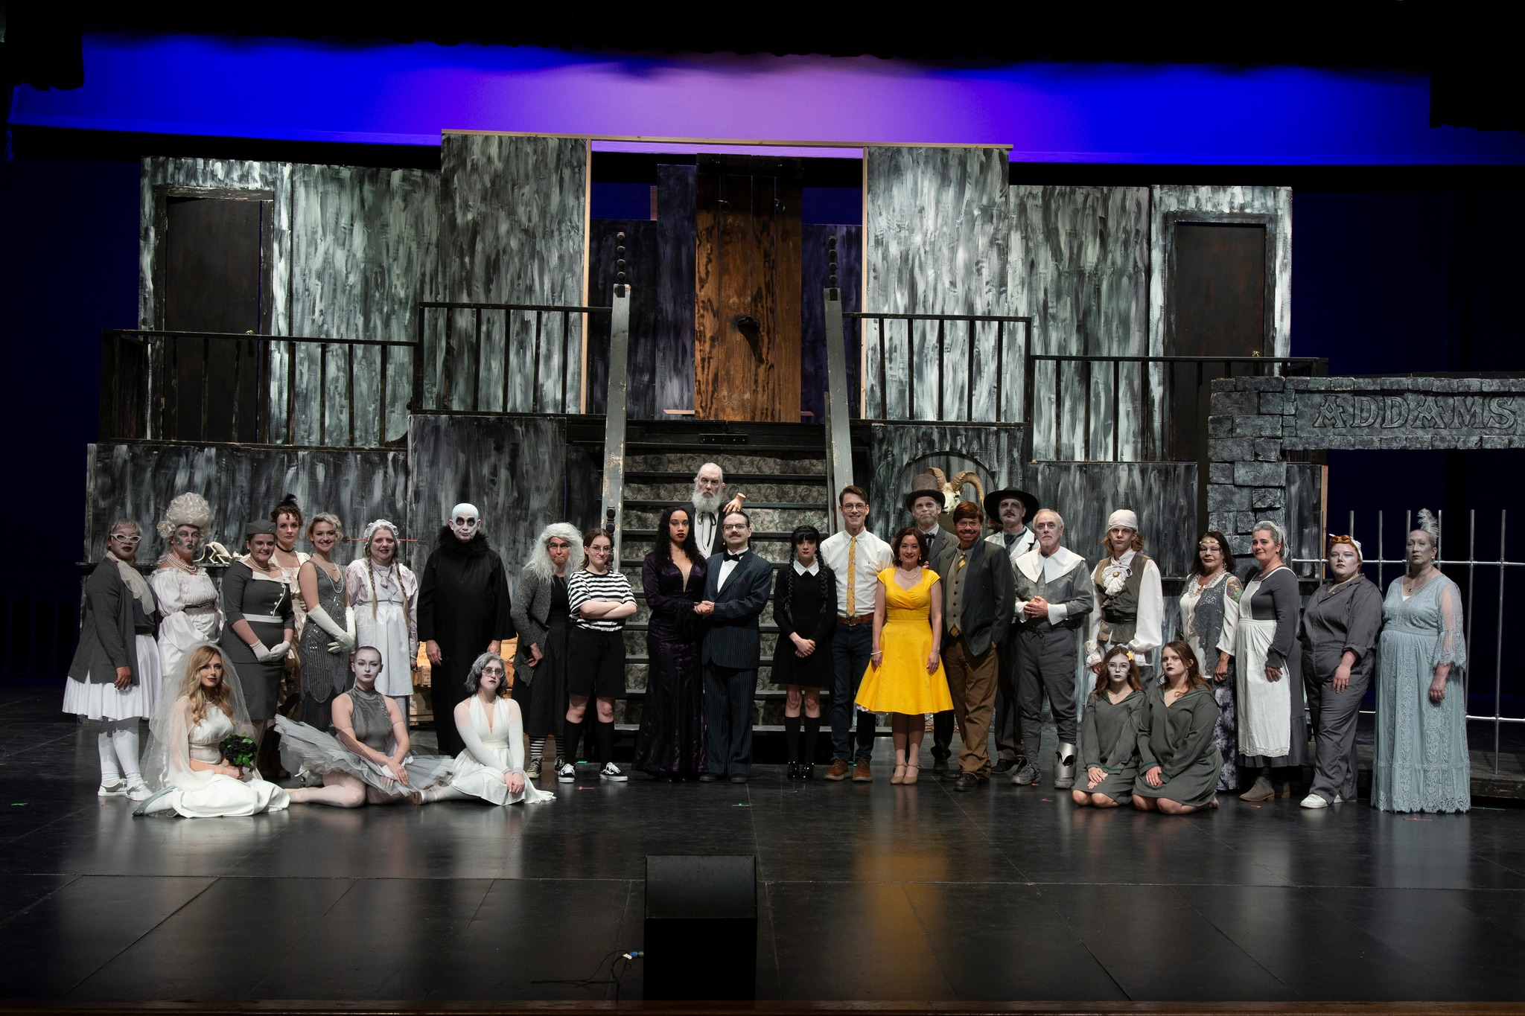
Arts & Culture
What You Said
Strength: Arts/Museums
Strength: Chisholm Trail Arts Council
Strength: Community Band Concerts
Strength: Chickasaw Nation
Weakness: Lack of Volunteers
Opportunity: Murals and Outdoor Art
Opportunity: Art Displays
Opportunity: Parades and Festivals
Photo from DLT Facebook Page
“Culture is the sum of all forms of art, of love, and of thought, which, in the course of centuries, have enabled man to be less enslaved.”
- André Malraux

Slide 16
Economic Development
What You Said
Strength: Business and Growth Opportunities
Strength: Proximity to Larger Markets
Strength: DAEDF
Strength: Chamber of Commerce
Strength: Low Taxes/Opportunity
Weakness: Bond Issues (Need Education)
Weakness: Need for Competitive Pay for Non-Skilled Workers
Weakness: Lack of Competitive Employment Opportunities
Weakness: Lack of Quality Restaurants
Opportunity: Downtown District
Opportunity: Citywide WiFi
Threat: Businesses Fighting for Same Funds
Threat: Low Investment/Reinvestment
“Government doesn’t create jobs, it only creates the conditions that make jobs more or less likely.”
- Mitch Daniels

Slide 17
Miscellaneous Topics
What You Said
Strength: Leadership
Strength: Humane Society
Strength: Think Ability
Strength: Douglass Center
Strength: McCasland Foundation
Weakness: Lack of Publicity
Weakness: Lack of Community Gateways
Weakness: Lack of Recycle Center
Opportunity: Community Billboard/Marque
Opportunity: Crapemyrtle Capital of OK
Opportunity: Ability to Increase Circulation of Local Dollars
Threat: We Wait for Others to Create Opportunities
Threat: Non-Profits are Fighting for Same Available Funding
Threat: Apathy
“Volunteering is the ultimate exercise in democracy. You vote in elections once a year, but when you volunteer, you vote every day about the kind of community you want to live in.”
- Author Unknown

Slide 18
Future Meetings
March 25, 2024
April 22, 2024
May 20, 2024 (3rd Monday)
June 24, 2024
July 22, 2024
August 26, 2024
September 23, 2024
October 28, 2024
November 18, 2024 (3rd Monday)
December 16, 2024 (3rd Monday)
“The creative process involves getting input, making recommendation, getting critical review, getting more input, improving the recommendation, getting more critical review… again and again and again.”
- Author Unknown

Slide 19

Thank you for sharing your input and visions for our future!
Nate Schacht, Director
Community Development
City of Duncan, Oklahoma
580-251-7715
nschacht@duncanok.gov

